Slide 1
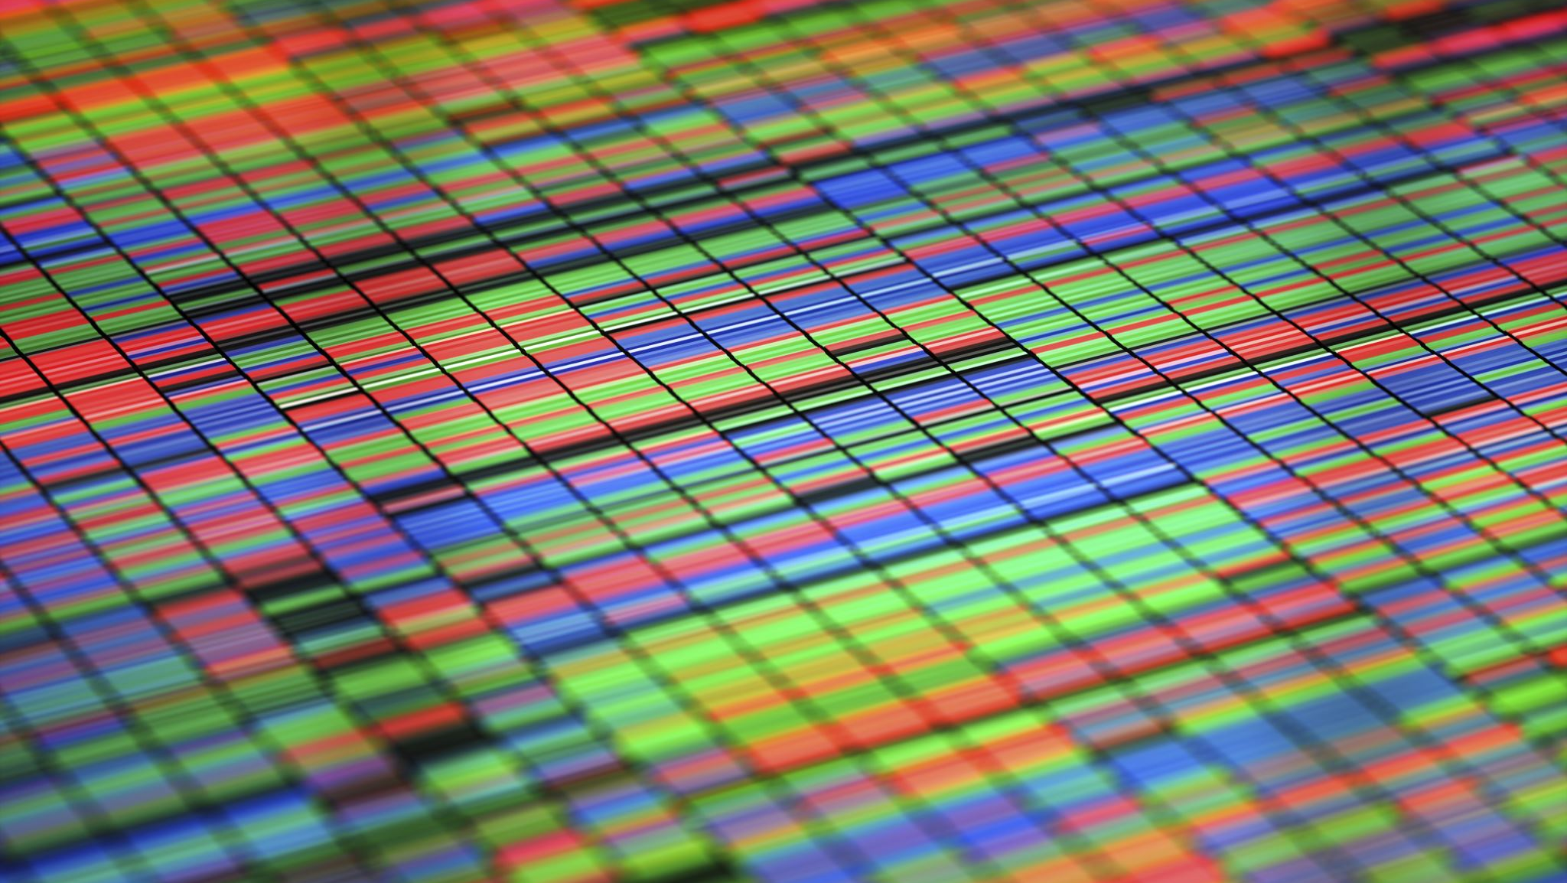
Min Graph Coloring Approximation Solution
John Curley
James Smith
Rhea Morris
Alyssa Sharp

Slide 2
How The Approximation Works
Creates two dictionaries based on the input
Graph: Which has the vertex as its key and the vertices its edges connect to as values
Degrees: Has the vertex as its key and the number of degrees for that vertex as its value
Calls the recursive function that will find the vertex with the greatest degree and then remove that vertex along with all its edges from the graph.
That removed vertex will get its own color in the graph
The updated graph and degrees are then passed recursively again until the vertex with the greatest number of degrees has a degree number of zero.
That final vertex and all remaining vertices will get the same color in the graph

Slide 3
Pseudocode
main():
num_vertices = # of vertices in graph
graph = vertices as keys, nodes connected to vertex as values (in list)
degree = vertices a keys, # of degree for vertex as values
print min_graph_coloring(graph, degree)
min_graph_coloring(graph, degree, num=1):
for vertex in degree
if degree[vertex] > max:
max_vertex = vertex
graph.remove(max_vertex)
degree.remove(max_vertex)
for node in graph:
for neighbor in node:
if neighbor is max_vertex:
node.remove(neighbor)
degree[node] -= 1
return min_graph_coloring(graph, degree, num + 1)

Slide 4
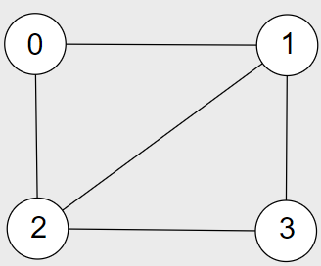
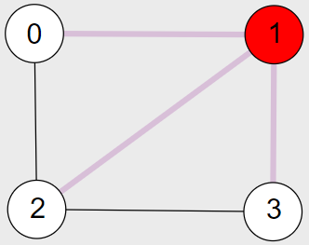
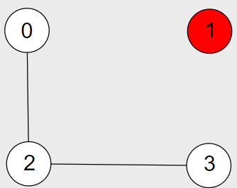
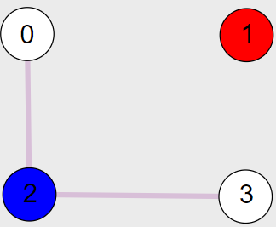
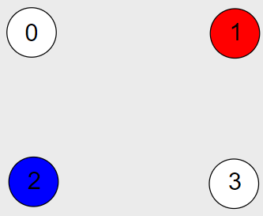
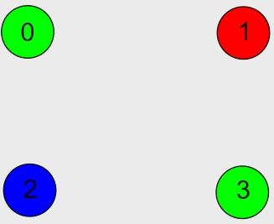
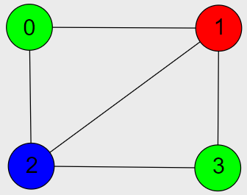
Steps of the Approximation Algorithm
Approximation Solution
Optimal Solution

Slide 5
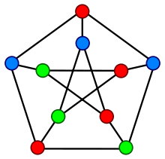
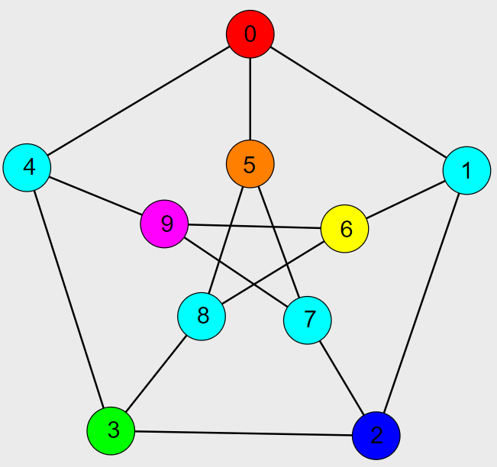
Not Always Optimal
The above graph represents the optimal solution possible for the graph
The below graph represents the results of our approximation algorithm
The approximation solution does yield a valid result however it is not the most optimal solution
Optimal Solution: 3 Colors
Approximation Solution: 7 Colors

Slide 6
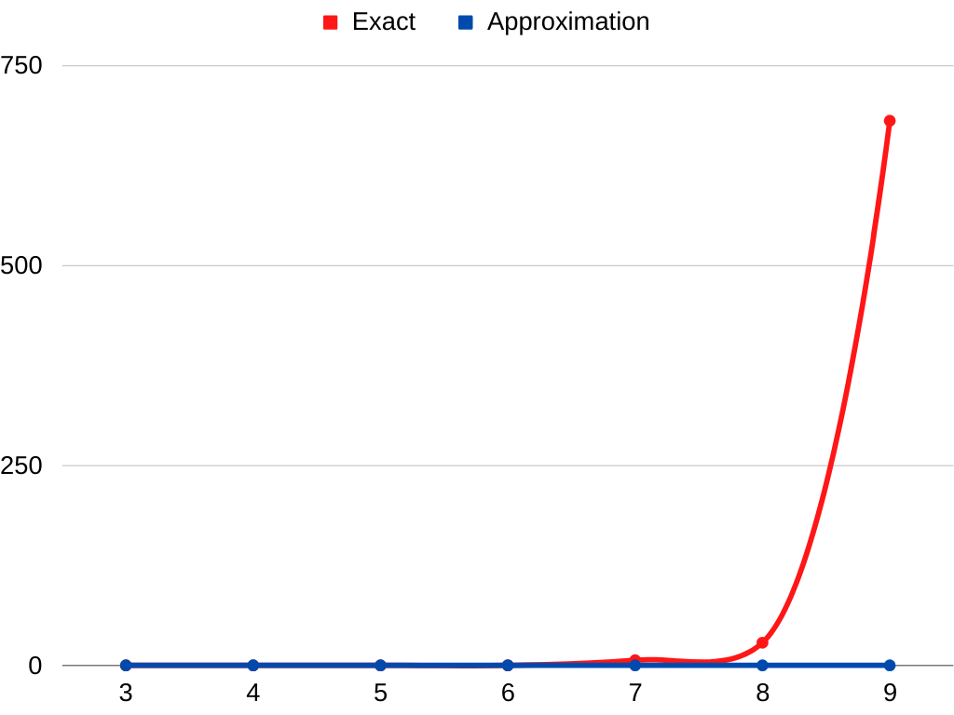
Run Time Results
Seconds
Nodes in Complete Graph

Slide 7
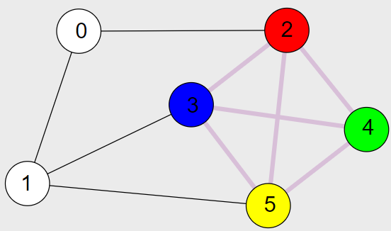
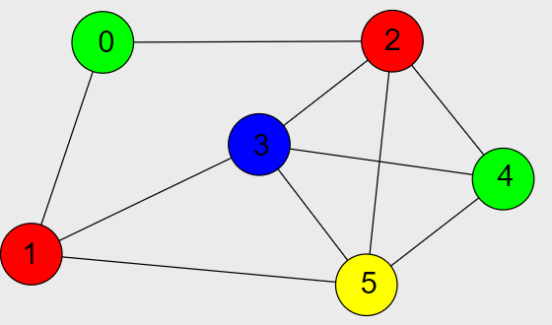
Lower Bound
Min Graph Coloring can be simplified into the Max-Clique np-complete problem.
If a max-clique exists in a graph its subgraph total number of nodes would be equal to the min number of colors needed in the graph
Nodes in Max Clique = 4
Min Colors = 4

